Slide 1
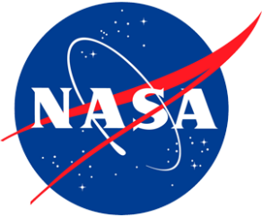
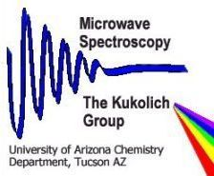
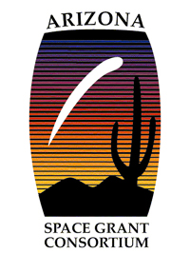
Digital Control System for Microwave Spectroscopy Data Collection
Amanda Olmut
Dr. Stephen Kukolich, Principle Investigator
Dr. Adam Daly, Project Lead
University of Arizona
April 16, 2016

Slide 2
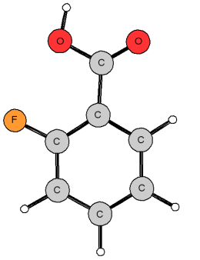
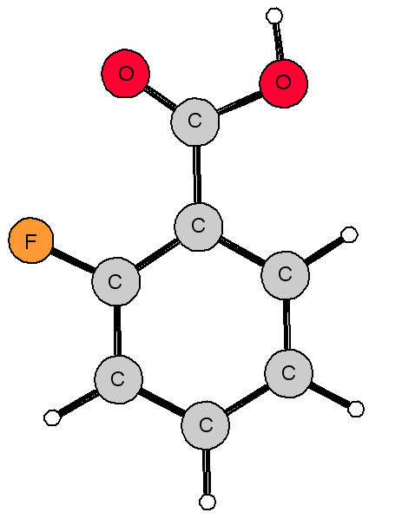
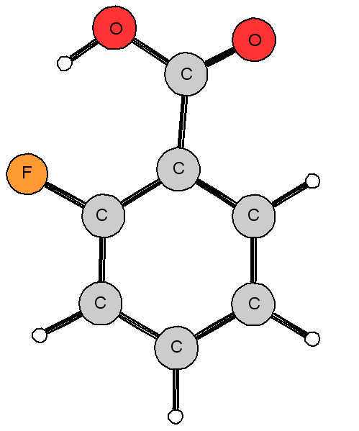
Applications of Microwave Spectroscopy
Accurate and precise method for measuring bond lengths and angles in free molecules
The complete, accurate, 3-D structures obtained are very helpful in:
Understanding reaction mechanisms
Characterizing the bonding
Characterizing electronic structures of molecules
Tells us how a molecule will behave
The frequencies measured provide positive identification of molecules observed in interstellar space
2-Fluorobenzoic Acid

Slide 3
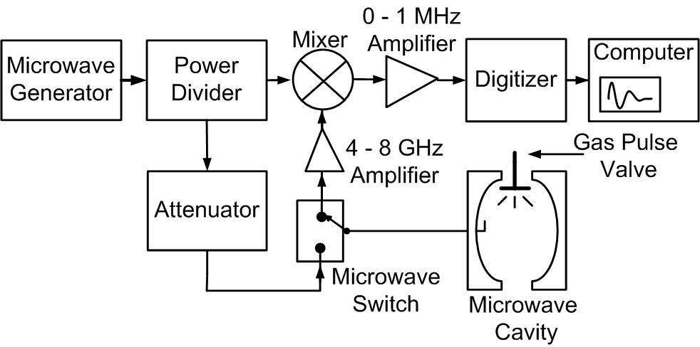
Microwave Spectroscopy - Control System Integration of New Technology
Molecules in the gas phase are pulsed into a chamber
Microwave radiation excites the molecules and they transition to higher energy levels
Molecules re-emit electromagnetic radiation
Measure the free induction decay (FID) signal and use a Fourier transform on this signal
Receive
Valve Signal
Transmit
Delay/Pulsewidth
Notes:
Need a control system to generate pulse sequences to:
record time domain spectra
optimize the mirror position for optimum performance

Slide 4
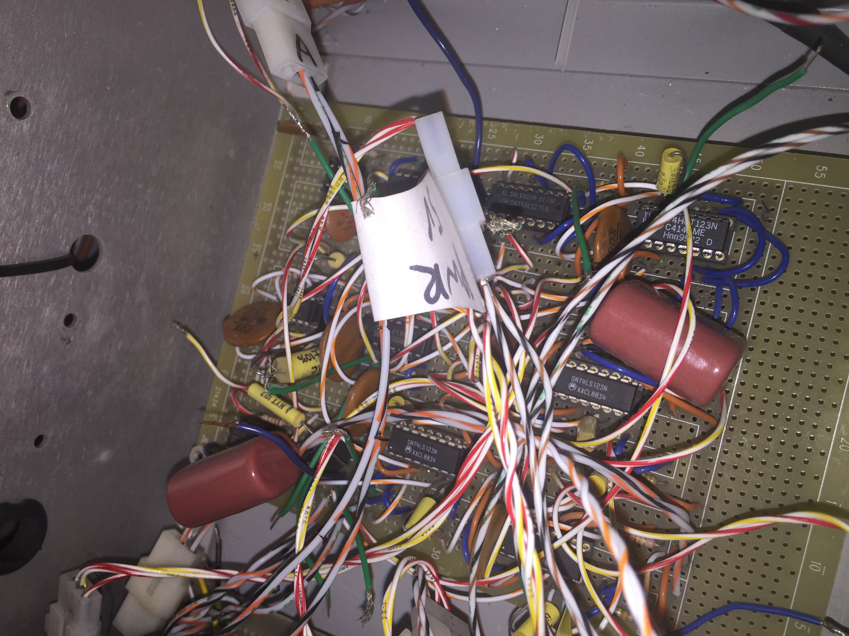
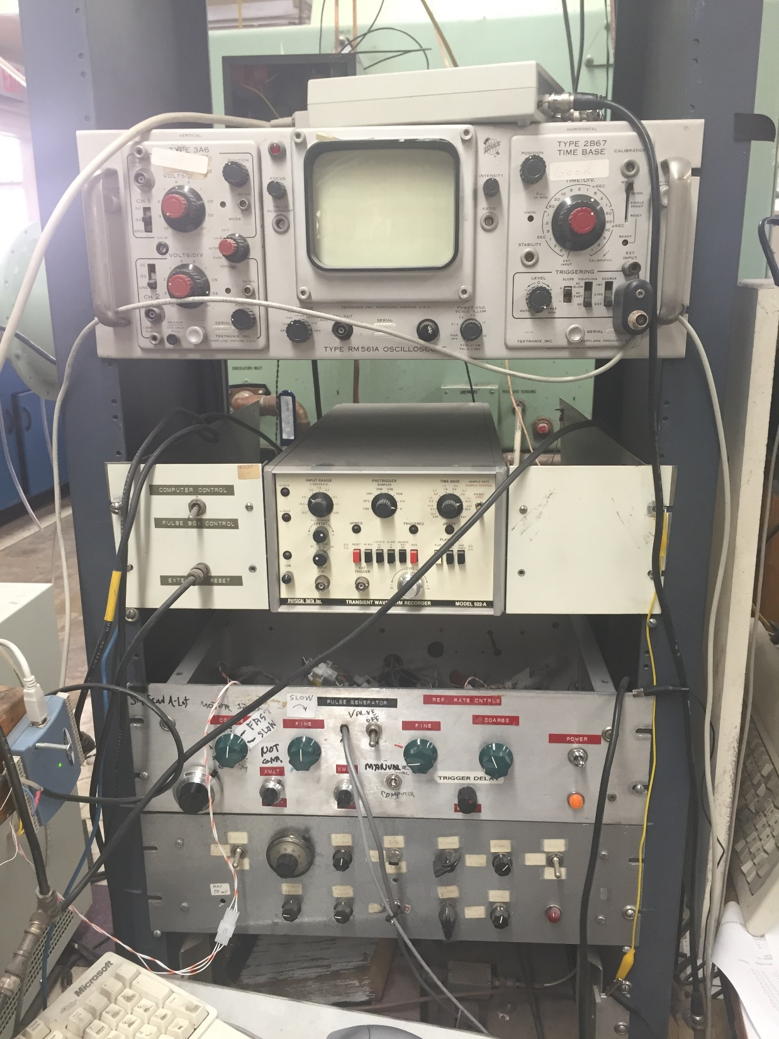
Old vs. New
Old system – electronics developed in the lab
New system:
Used data acquisition boards from National Instruments
Used LabVIEW to create an interface for automated or operator control of the spectrometer
Ability to perform double resonance experiments
Simplified, modern, and easy to copy
Old System

Slide 5
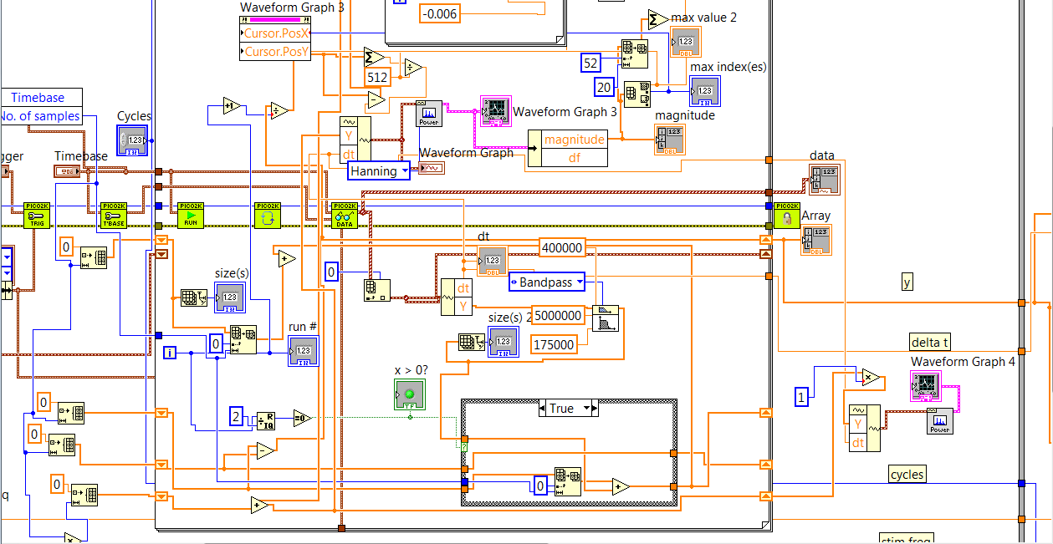
Old vs. New
LabVIEW Virtual Instrument Block Diagram

Slide 6
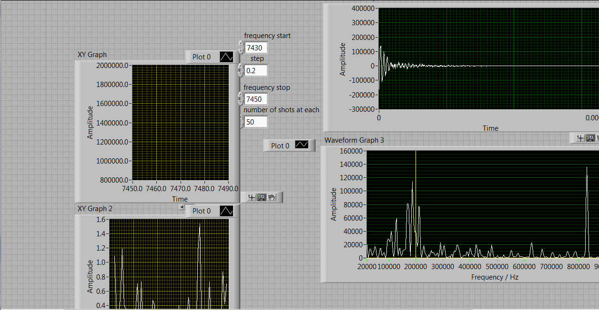
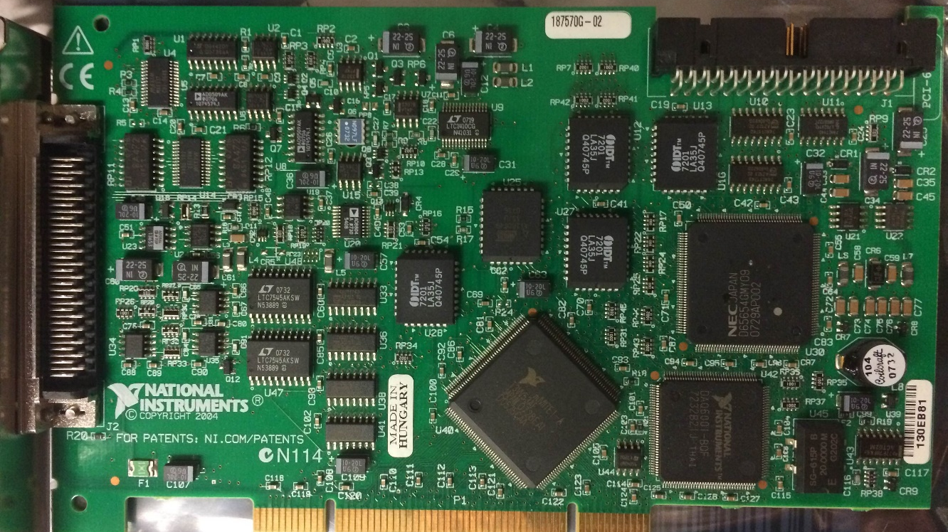
Old vs. New
LabVIEW Virtual Instrument Front Diagram
National Instruments 6024 DAQ Board

Slide 7
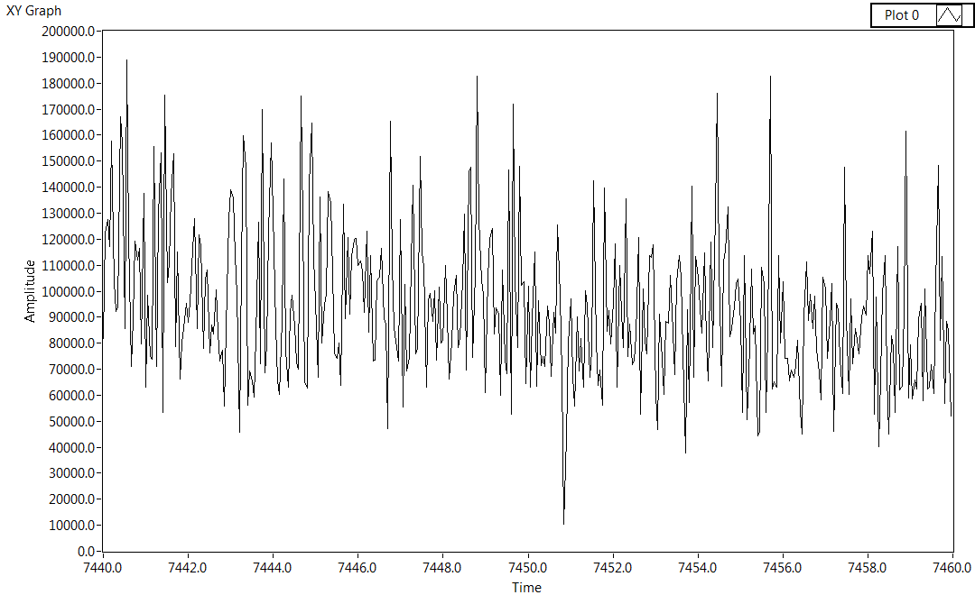
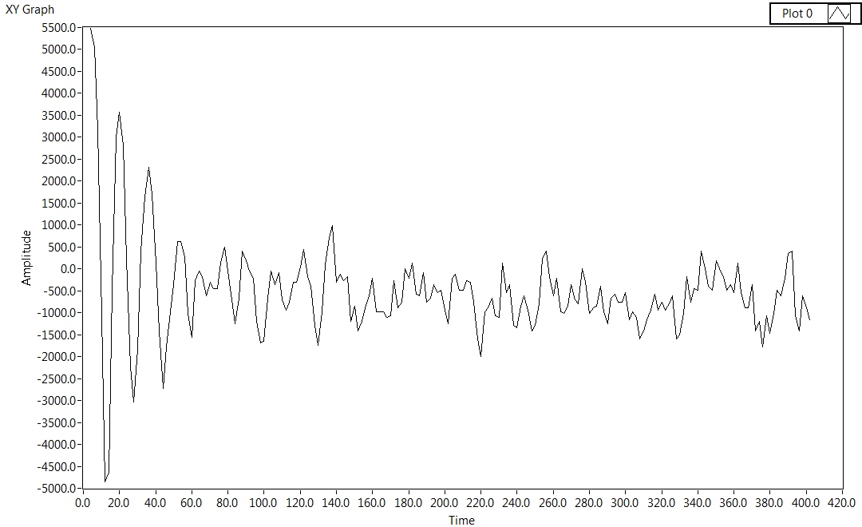
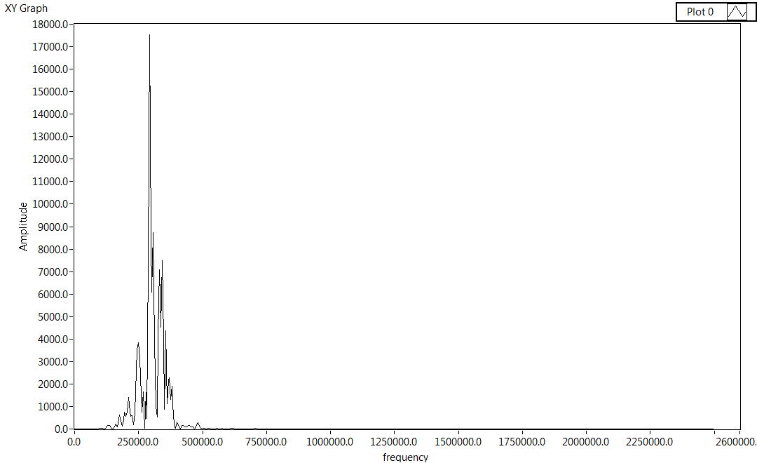
Results
FID
B-type
A-type
4⁻₀₄
4⁺₀₄
3⁻₁₃
3⁺₁₃
3⁻₀₃
3⁺₀₃
Transform
Rotational Spectroscopy

Slide 8
Conclusions
Sophisticated control system
Able to scan large frequency regions and analyze complex spectra
Successfully performed double resonance experiment
Future Work
Engineering task – optimizing our system
Testing
Laser fragmentation experiment on another spectrometer
Make sigma 3 detection (currently sigma 1.5 detection) for double resonance

Slide 9
Acknowledgements
This project would not have been possible without NASA, Arizona Space Grant Consortium, Dr. Kukolich and Dr. Daly, and the UA Department of Chemistry and Biochemistry.

Slide 10
Thank you!

